Slide 1
Bike-sharing
Progress Report

Slide 2
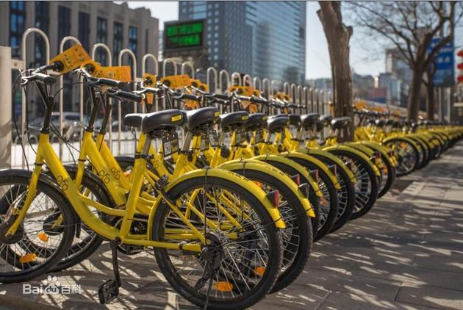
Benefit
All images are from the network.
Notes:
1.Popularity: We can see a lot of blue/yellow-colored bikes lining up in our campus and also in some big cities.
2. Benefits: A healthy way of traveling.

Slide 3
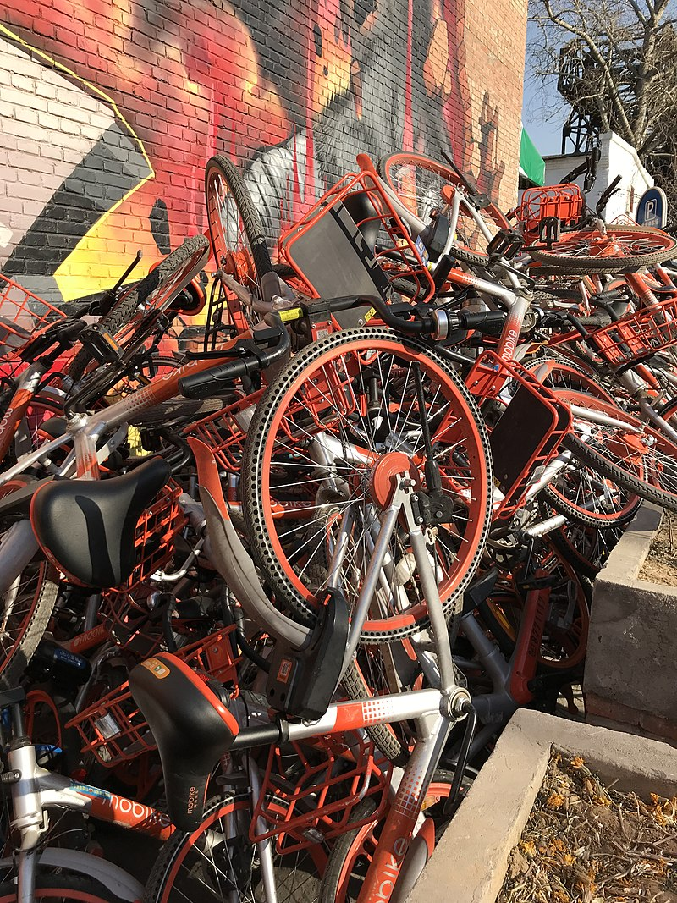
Or Waste?
All images are from the network.
Notes:
Some companies are facing serious financial problems, even bankrupt (cannot refund the deposit).
A lot of bikes are wasted or broken by people on purpose.

Slide 4
Is bike-sharing system really beneficial to our city?

Slide 5
Bike-sharing
Benefits:
Environmentally friendly;
Good to our health;
Ease traffic congestion;
……

Slide 6
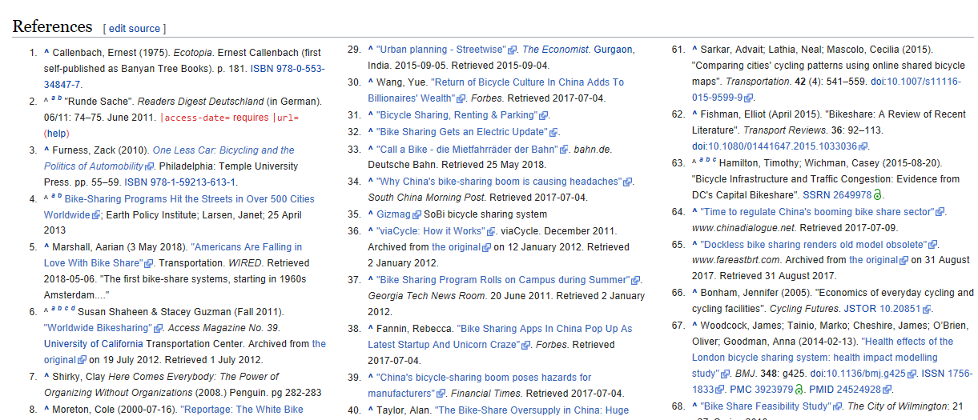
Criticisms?
Economical impact
Public health
Privacy

Slide 7
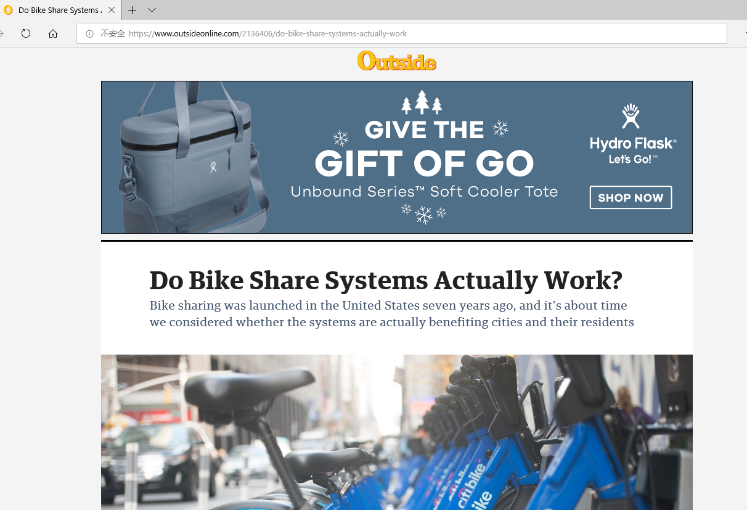
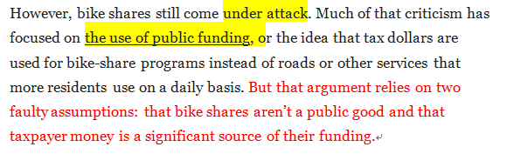
Economically
A waste of public funding
Bikes occupy the car parking area
Many bikes are broken or wasted deliberately by people
Notes:
Someone said those funding can be used otherwise to improve our infrastructure, e.g. road construction.
Building docks/ over-supply of bikes
Need supervision, laws.

Slide 8
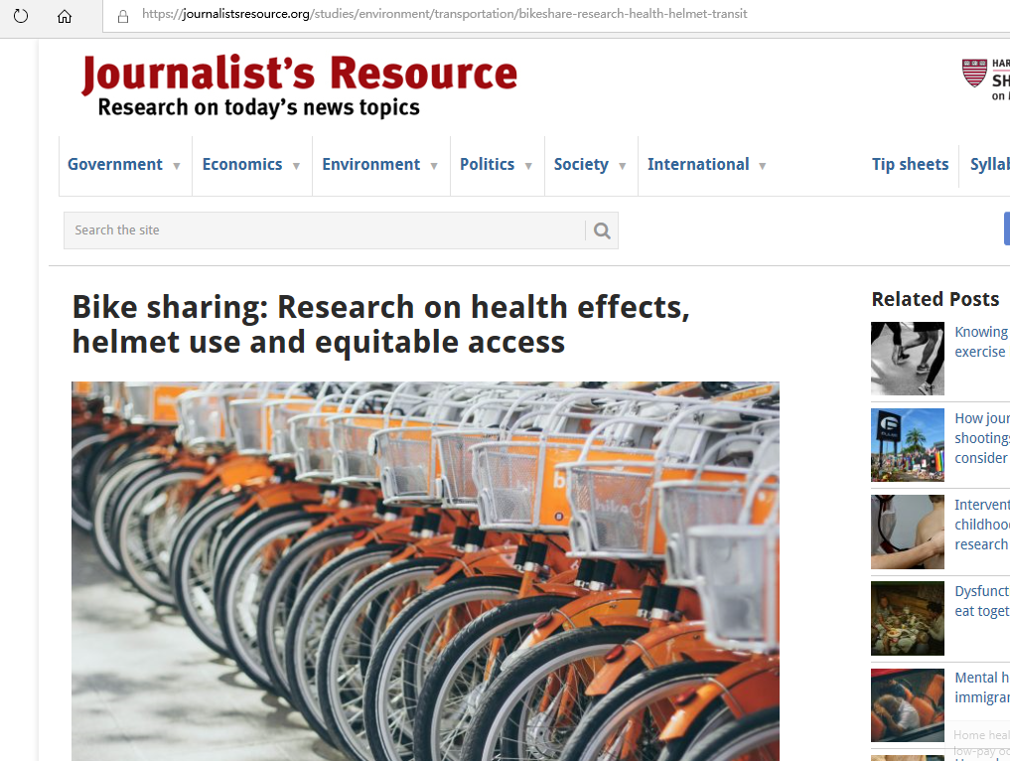
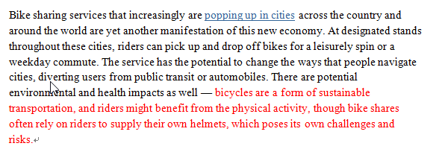
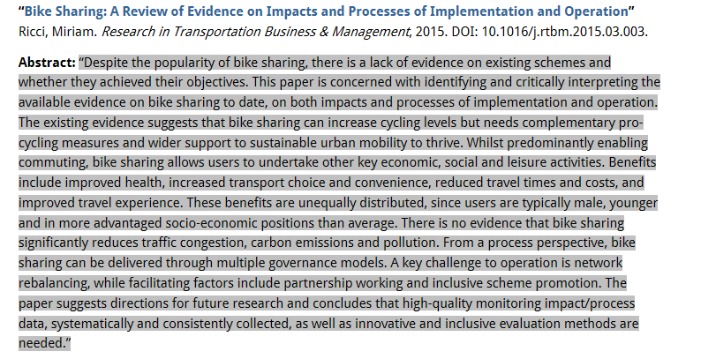
Public health
The street is not safe enough for so many bike riders
Bikes need to be
equipped with
helmets
Notes:
In 2016, a woman in America was killed in street when riding shared bike.
Riders seldom prepare helmet. They have low safety consciousness.

Slide 9
Privacy
Companies may collect users’ data for advertising or making profit.
Notes:
Company regulates bikes by Internet. People’s privacy is likely to be invaded.

Slide 10
Bike-sharing is indeed beneficial
It’s not a waste of public funding.
The initial goal of bike-sharing is good;
Being run by non-profit organizations and strengthening supervisions may address those problems.
It promotes healthy way of travelling.
Reduce car using, protect the environment and ease congestions;
Address the “last mile” problem.
It creates a new social pattern of sharing
The quality of citizens should be improved to catch up with the development of society.

